Slide 1
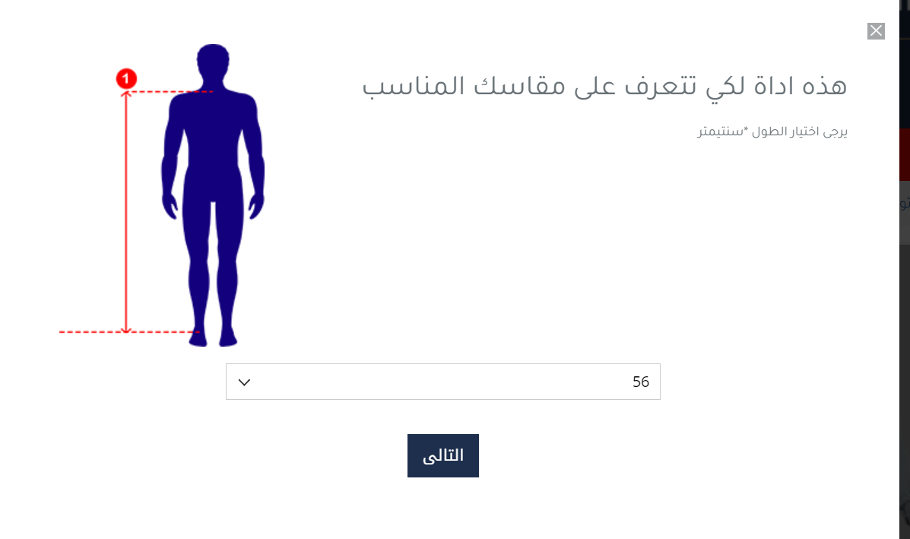
ثياب رجالية و بشوت https://www.alshiaka.com/size-selector.html https://salla.sa/alghina/DYPaeD

Slide 2
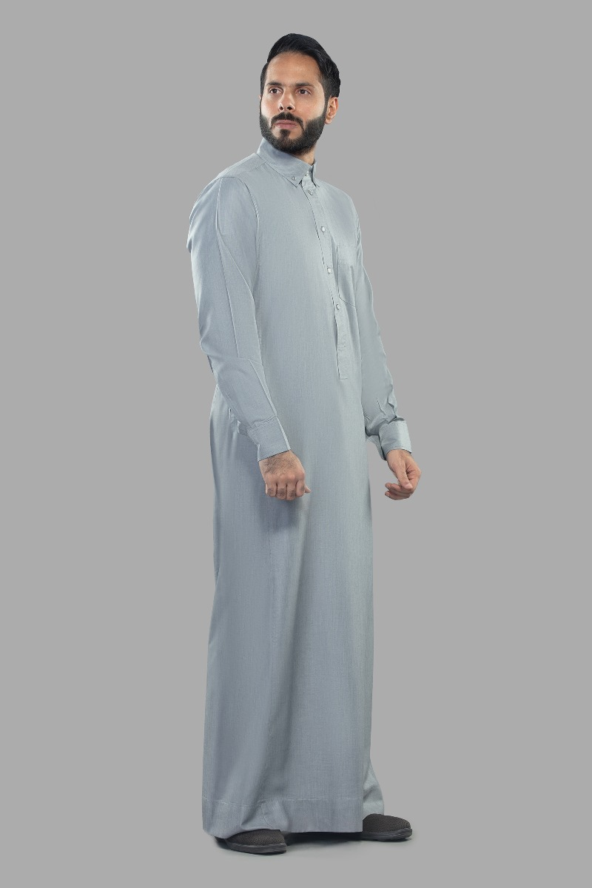
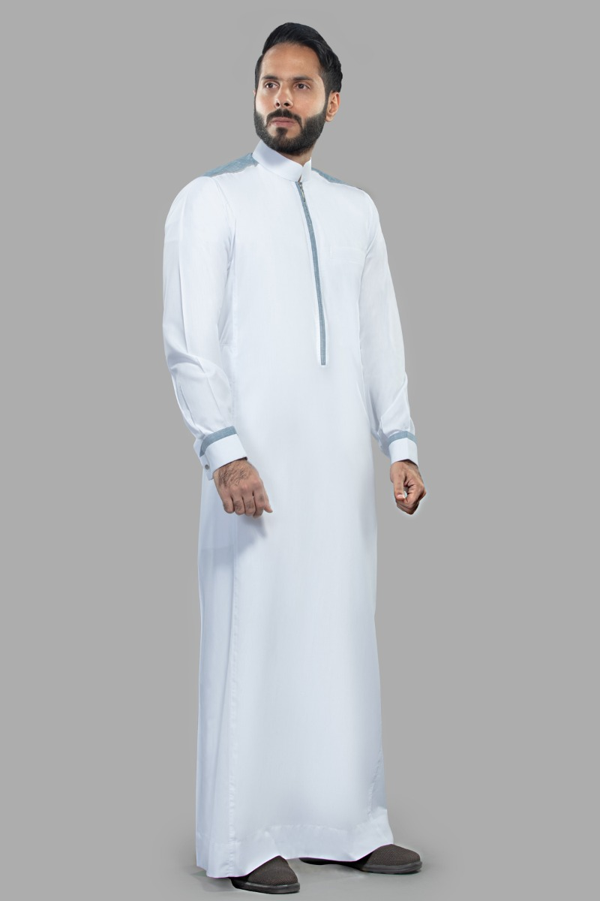
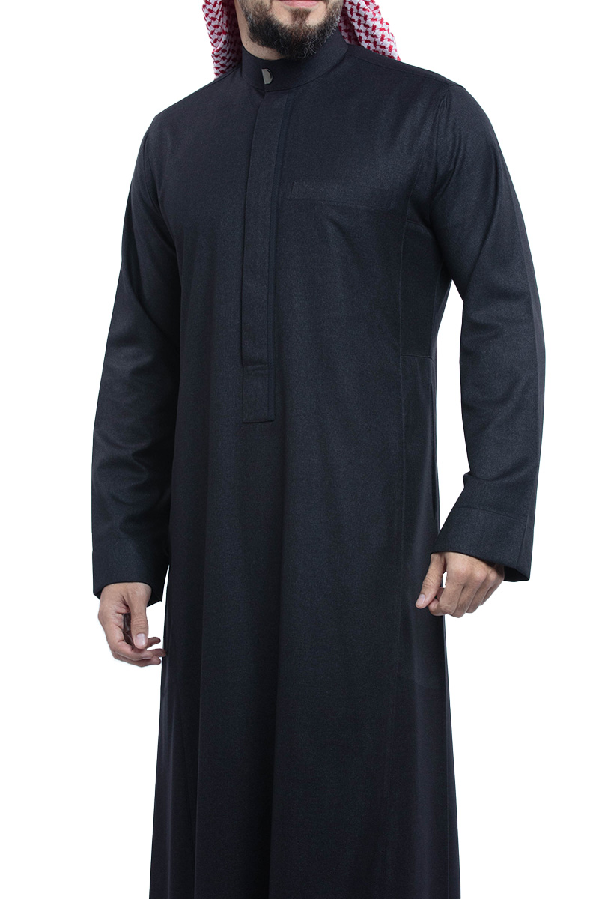
اثواب
Sleeves: cuff
Chest area: buttons
Color: Gray
Fabric: Spun Canvas
Sleeves: cuff
Chest area: zipper
the color is white
Fabric: Spun Canvas
Color: black
Sleeves: Plain
Chest area: hidden zipper
Fabric:

Slide 3
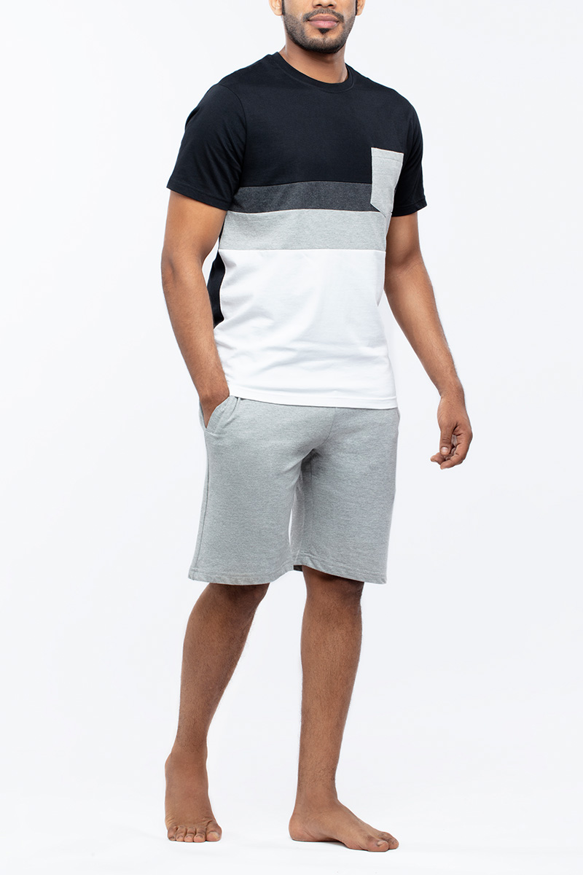
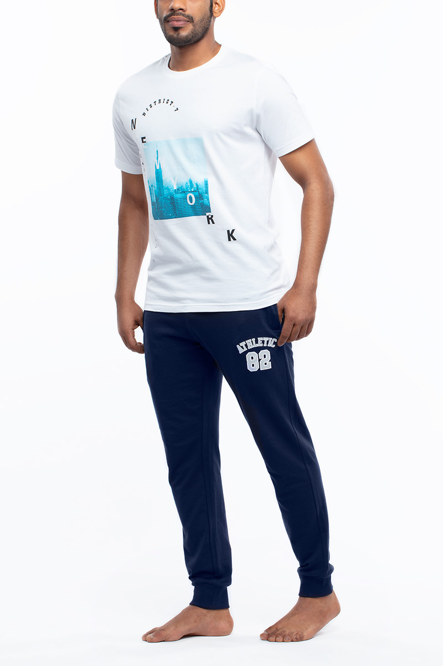
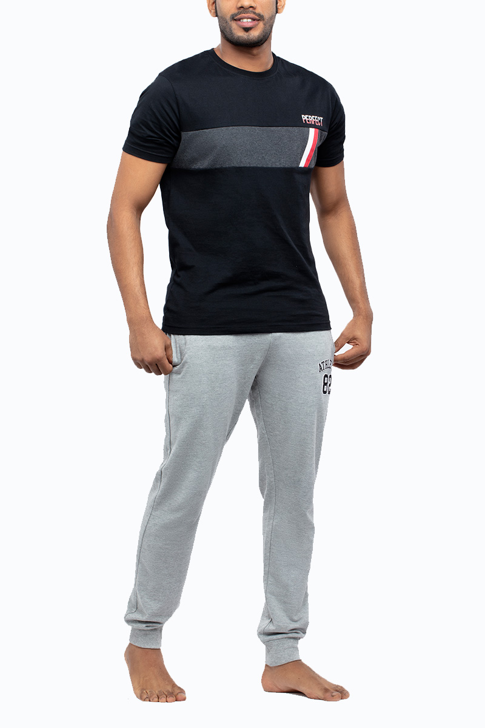
بيجامات
Color: white, blue
Fabric: Cotton
Color: white, blue
Fabric: Cotton
Color: gray, black
Fabric: Cotton

Slide 4
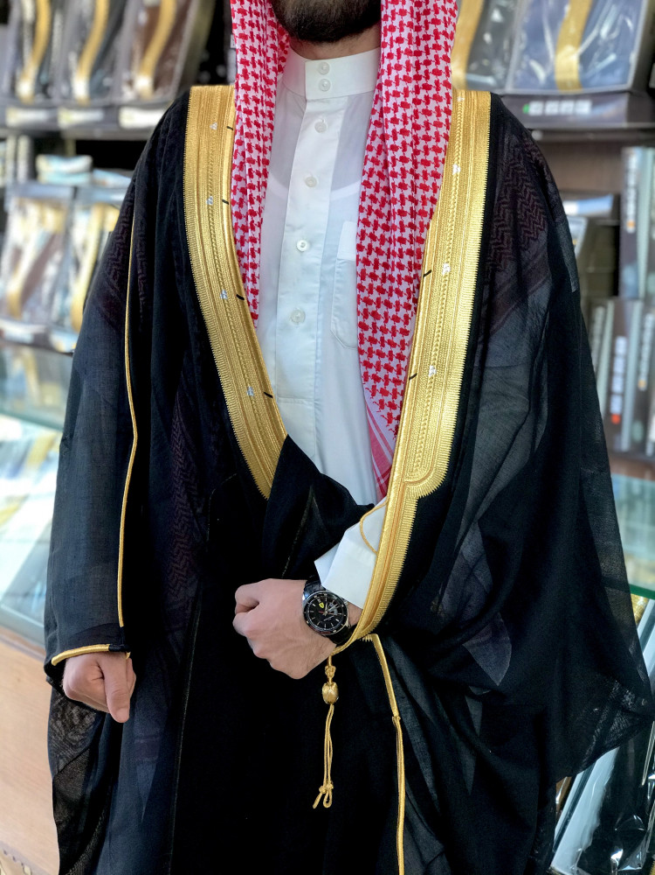
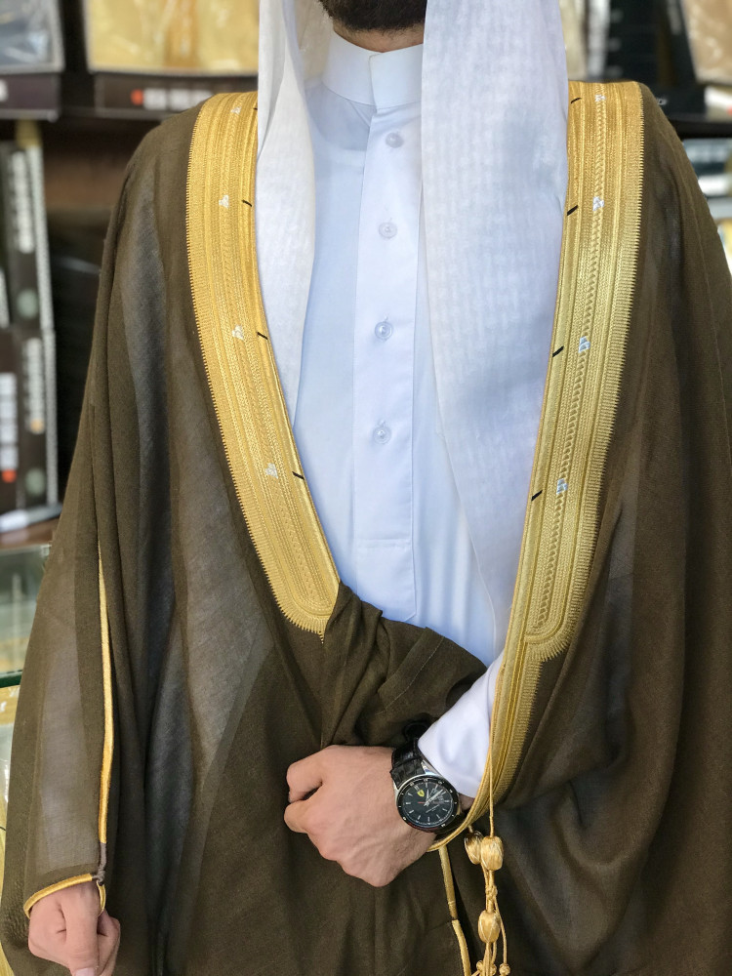
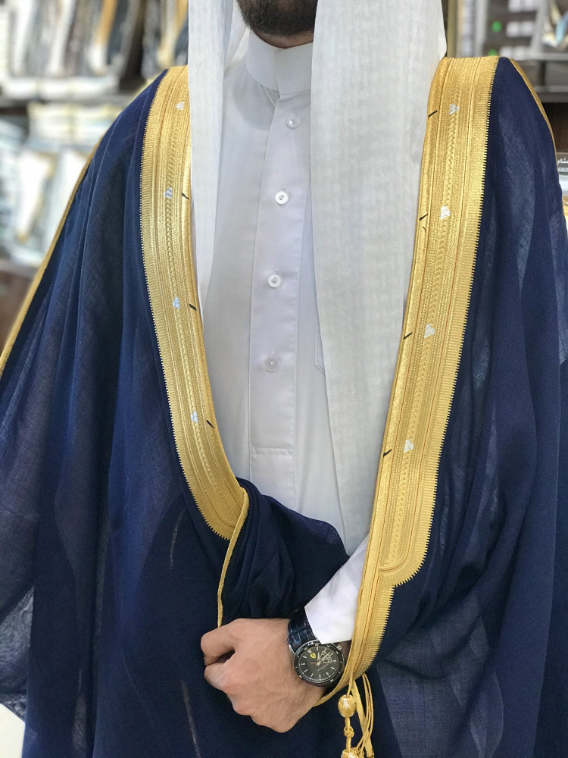
بشت
Black color
Fabric: Korean fabric, French cane
Color: Dark Olive
Fabric: 100% German cane wool Japanese fabric
Color: Dark blue
Fabric: 100% German cane wool Japanese fabric

Slide 5
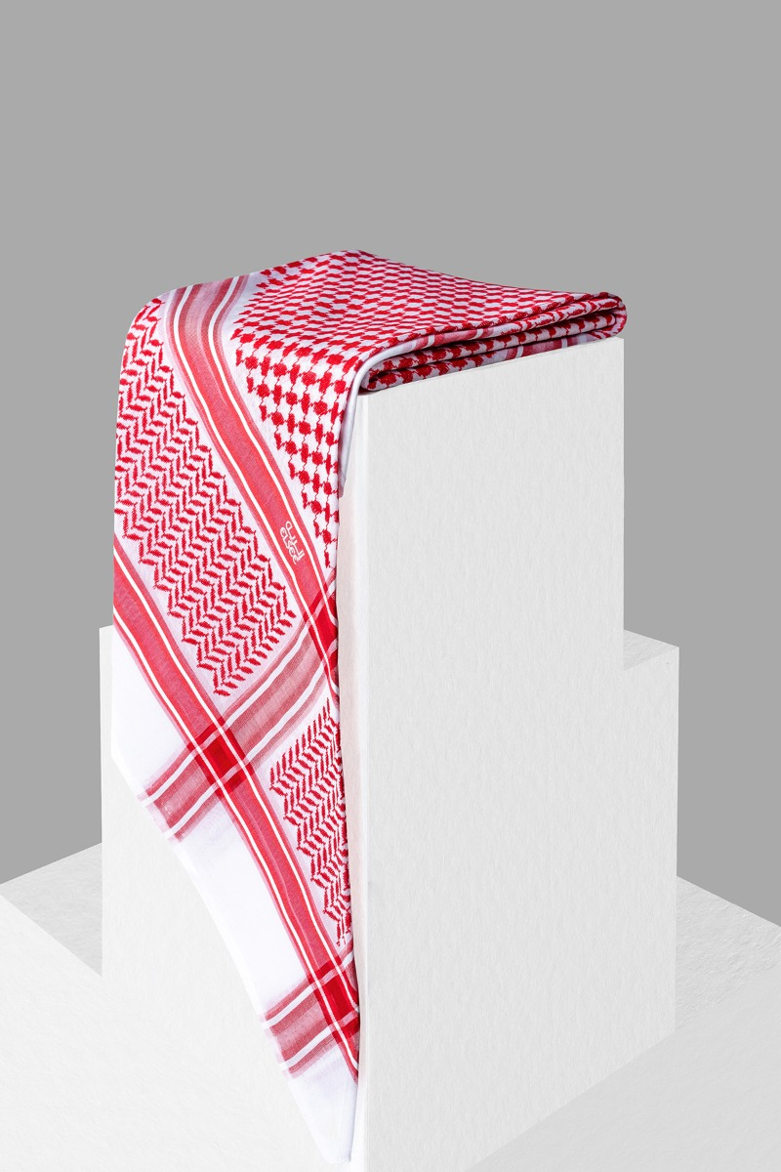
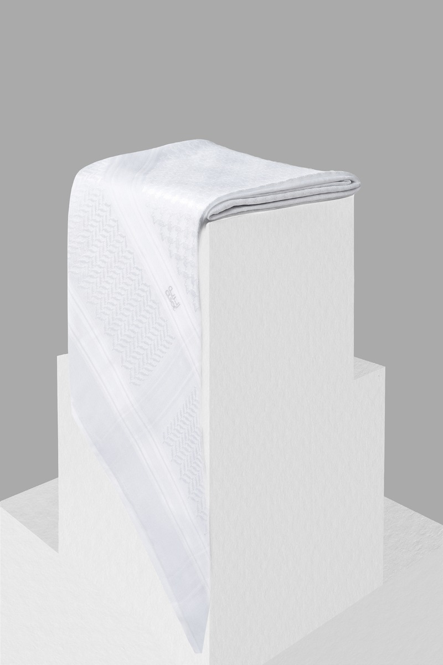
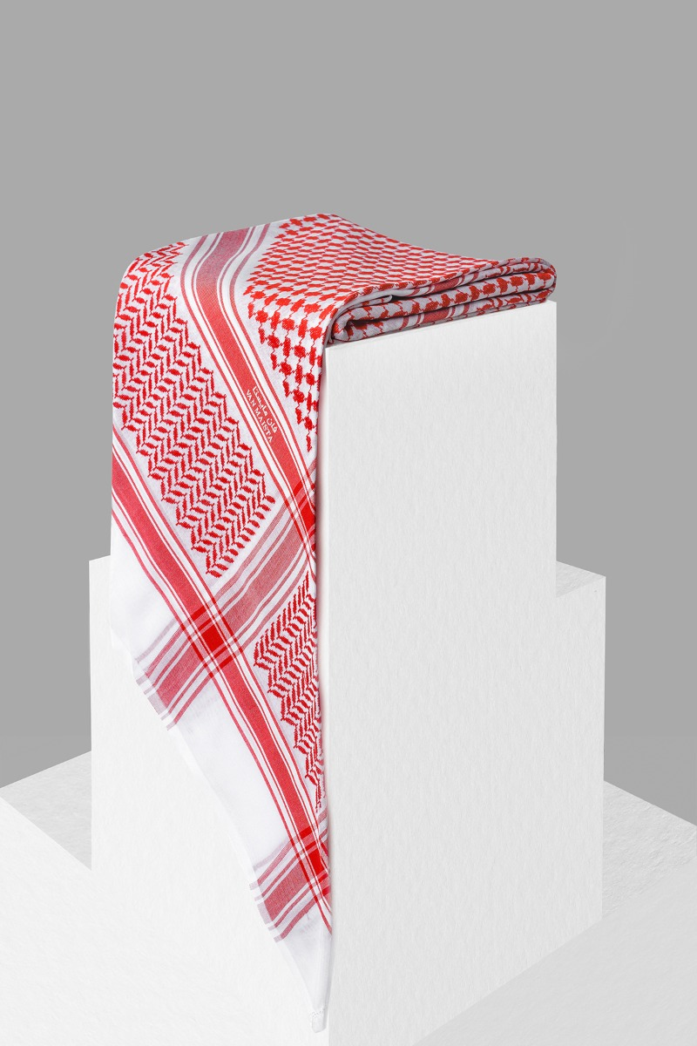
شماغ
Color: Red
Fabric: Cotton
Color: white
Fabric: Cotton
Color: Red
Fabric: Cotton

Slide 6
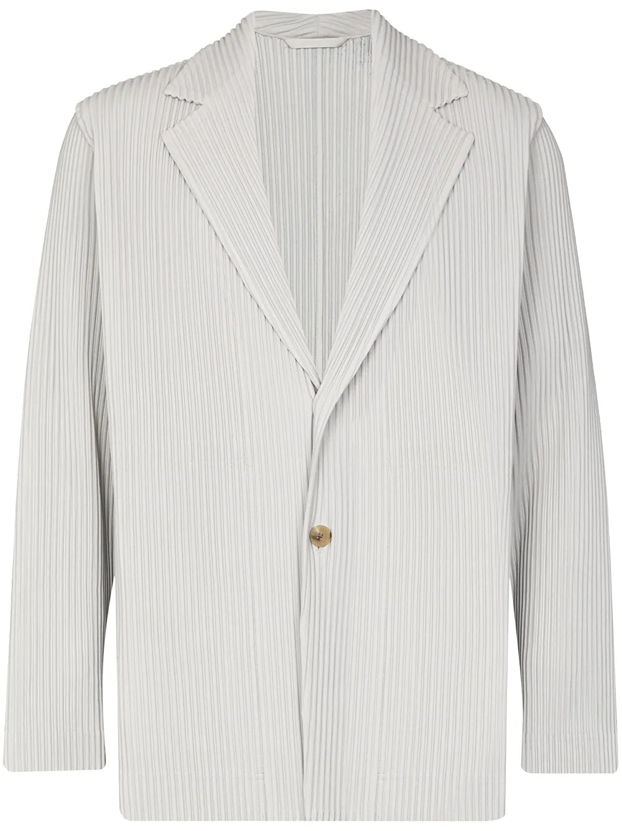
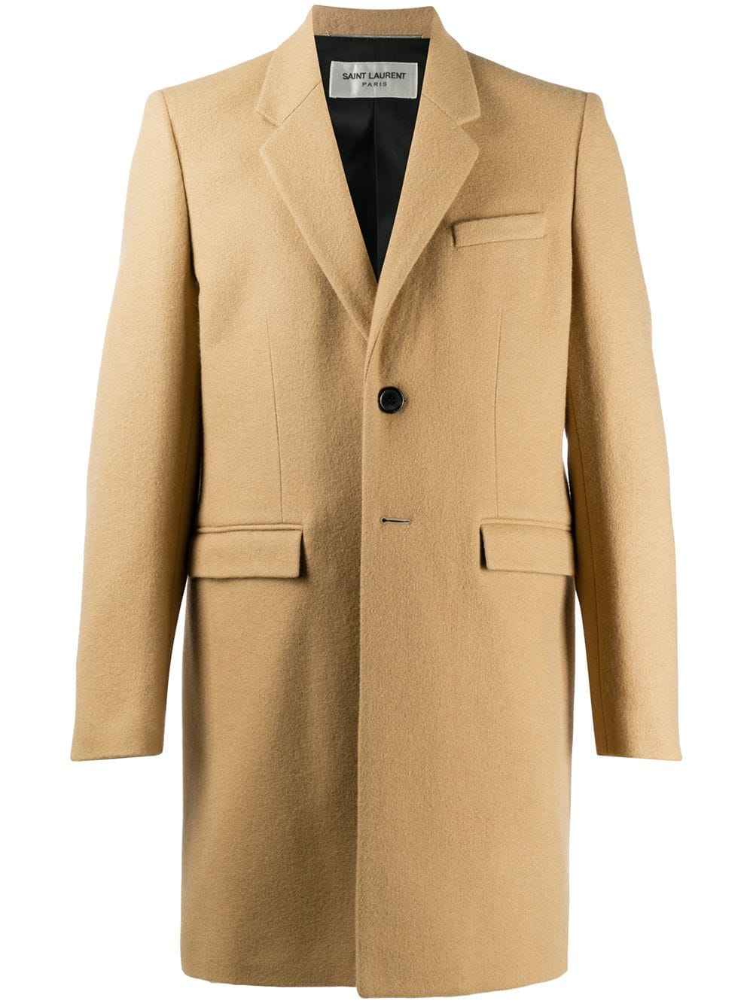
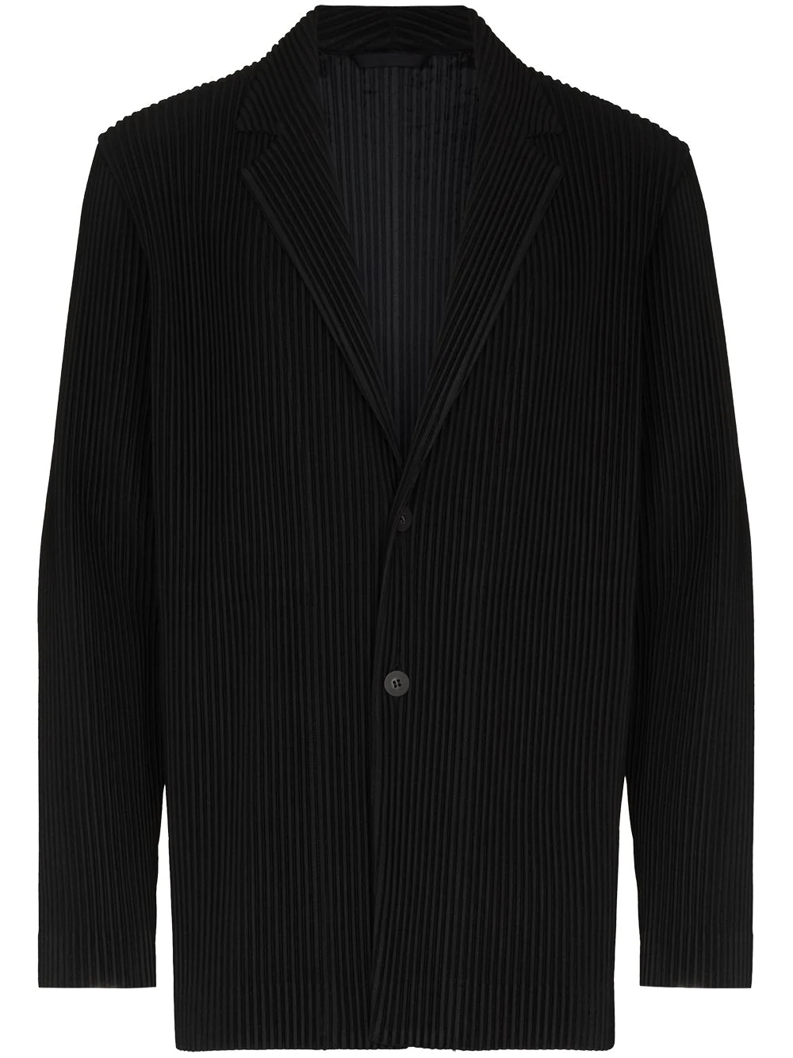
جاكت
Color: black
Fabric: 100% polyester
Color: light brown
Fabric: outer part: 100% wool
Lining: Cupro 60%, Cotton 40%
Color: white
Fabric: 100% polyester
https://www.farfetch.com/ar-sa/shopping/men/jackets-2/items.aspx

Slide 8
جكيت و تشيرت

